Slide 1
Welcome!
Sherlin Whaley
Certified Data Scientist

Slide 2
Why Education?
Student grades serve as a marker to determine a student’s progress and their concept mastery level.
Concept mastery is important because it is the indicator by which someone has learned a new skill, trade or concept.
Failing students, generally, have been deemed to not have learned a concept well enough to be able to complete that task with at least 70% accuracy.

Slide 3
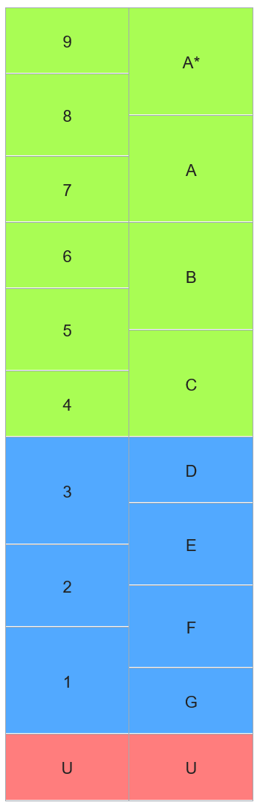
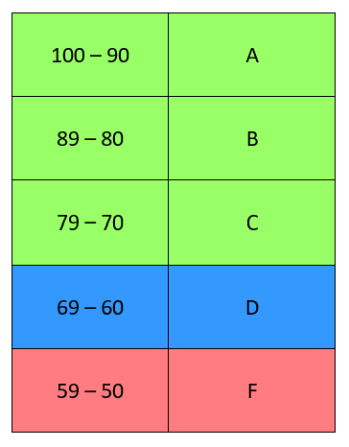
UK Grades Vs. US Grades
Grades in the UK
Grades in the US

Slide 4
Mission Statement/Goals
To provide schools and districts with an optimal view of their student’s data.
To objectively come to relevant and insightful conclusions based on the data.

Slide 5
Methods
Data Source: Kaggle.com
Data Content: Student Grades from the UK
Analyses Performed:
Linear Regressions 1 & 2
Random Forest
Step-wise Regression
Basic ANOVAs 1, 2 & 3

Slide 6
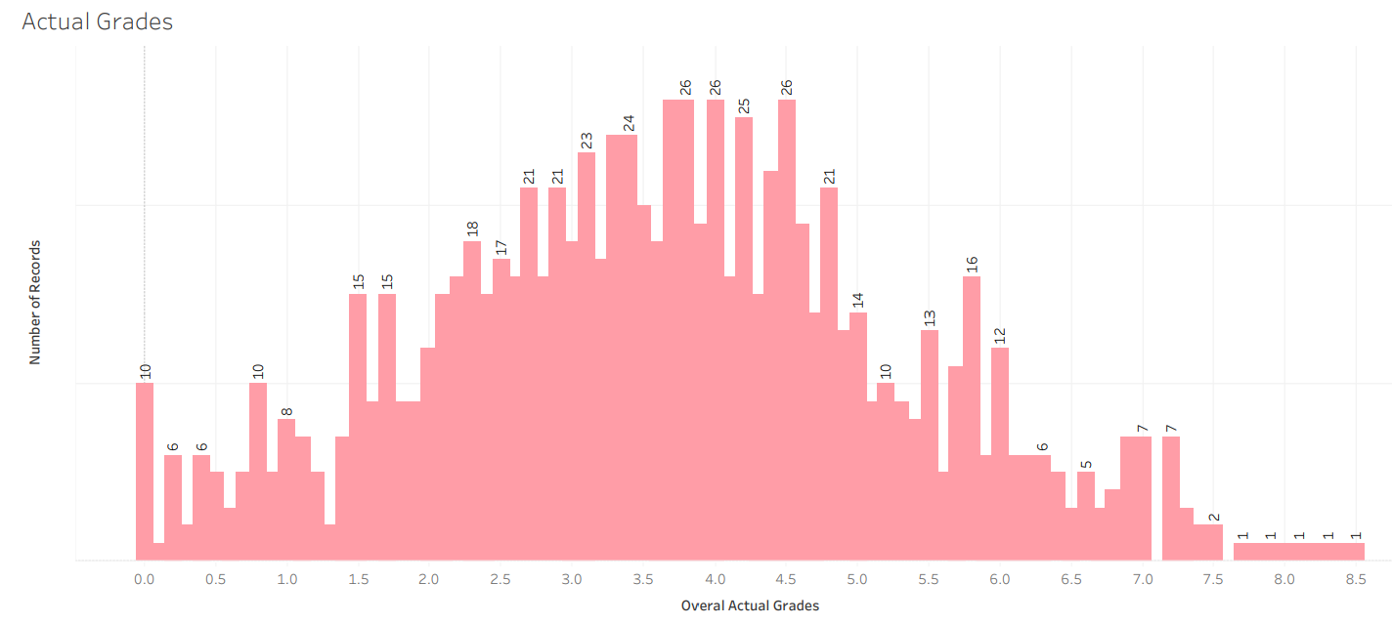
Overall Average of All Earned Grades

Slide 7
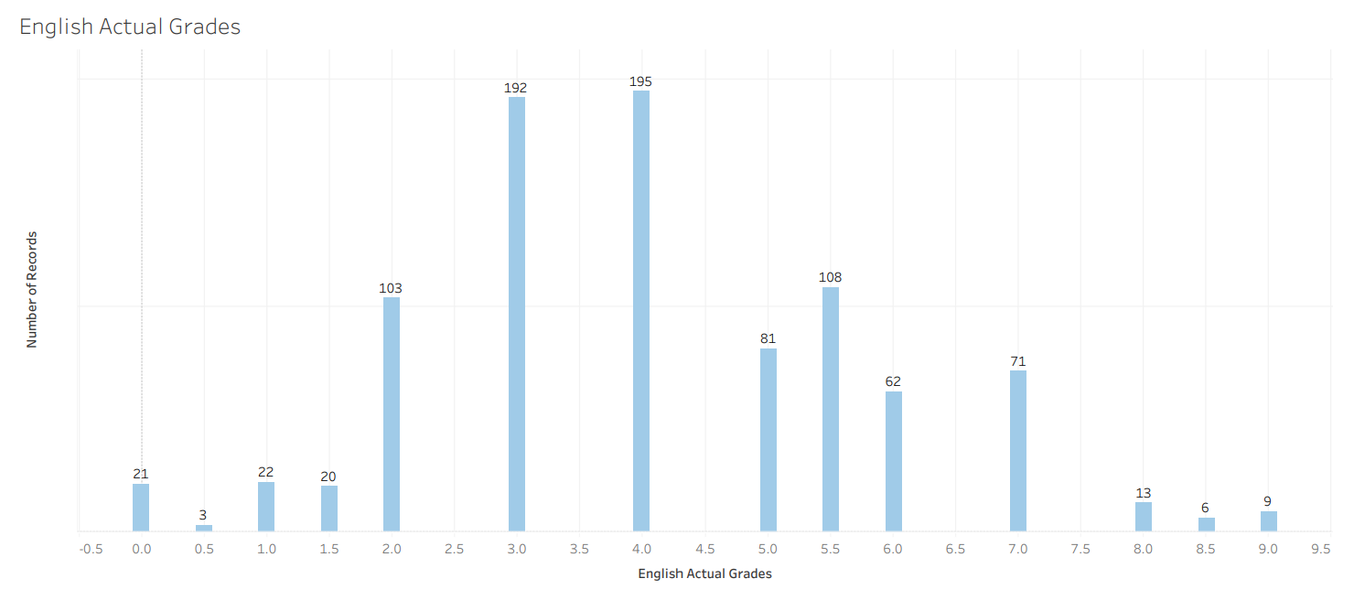
English Earned Grades

Slide 8
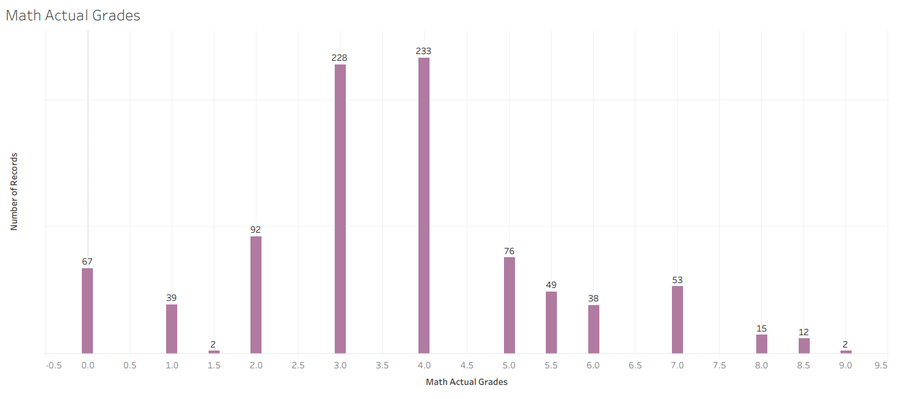
Math Earned Grades

Slide 9
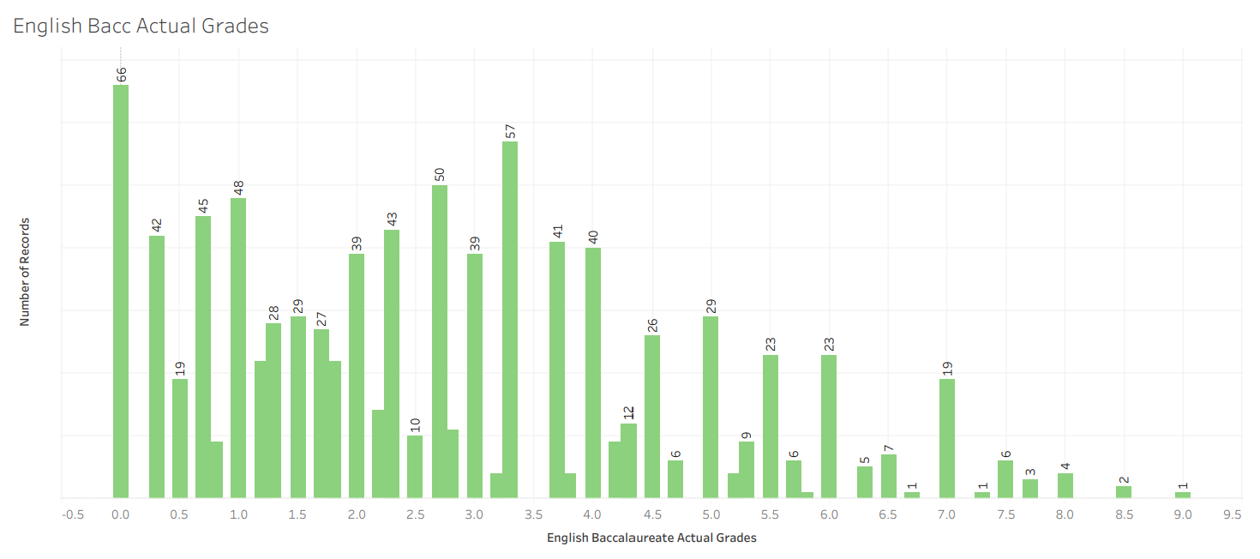
English Baccalaureate Earned Grades

Slide 10
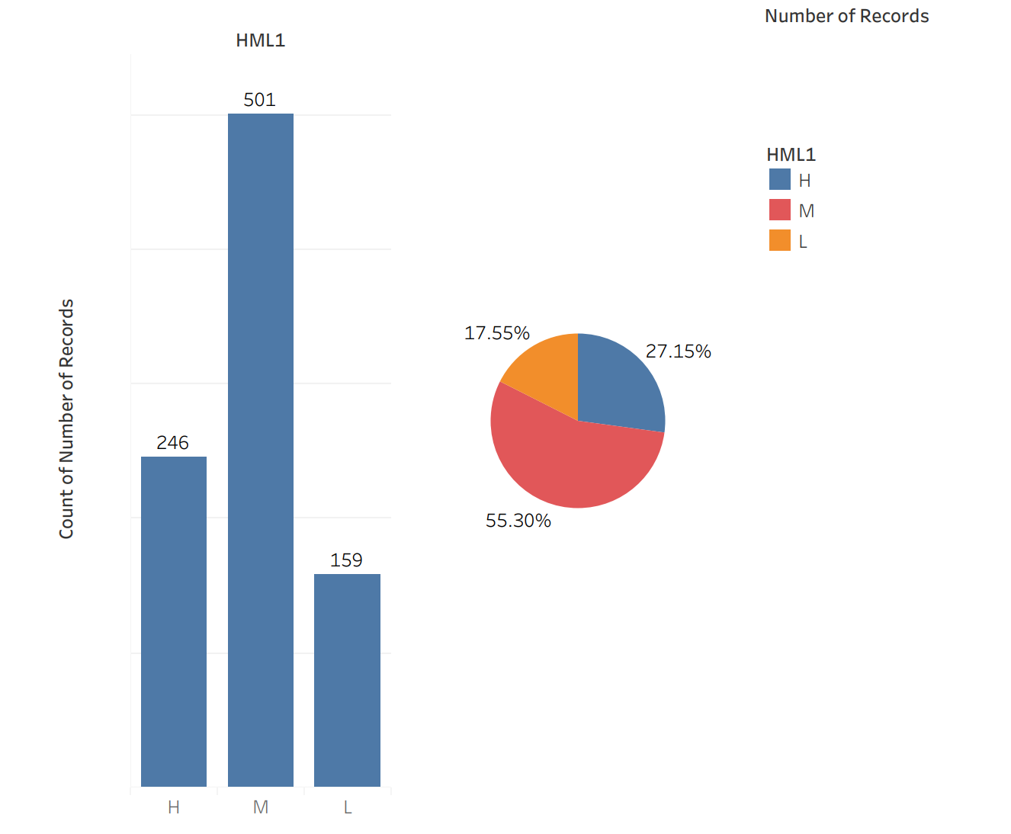
Students by Learner Level High – Medium - Low

Slide 11
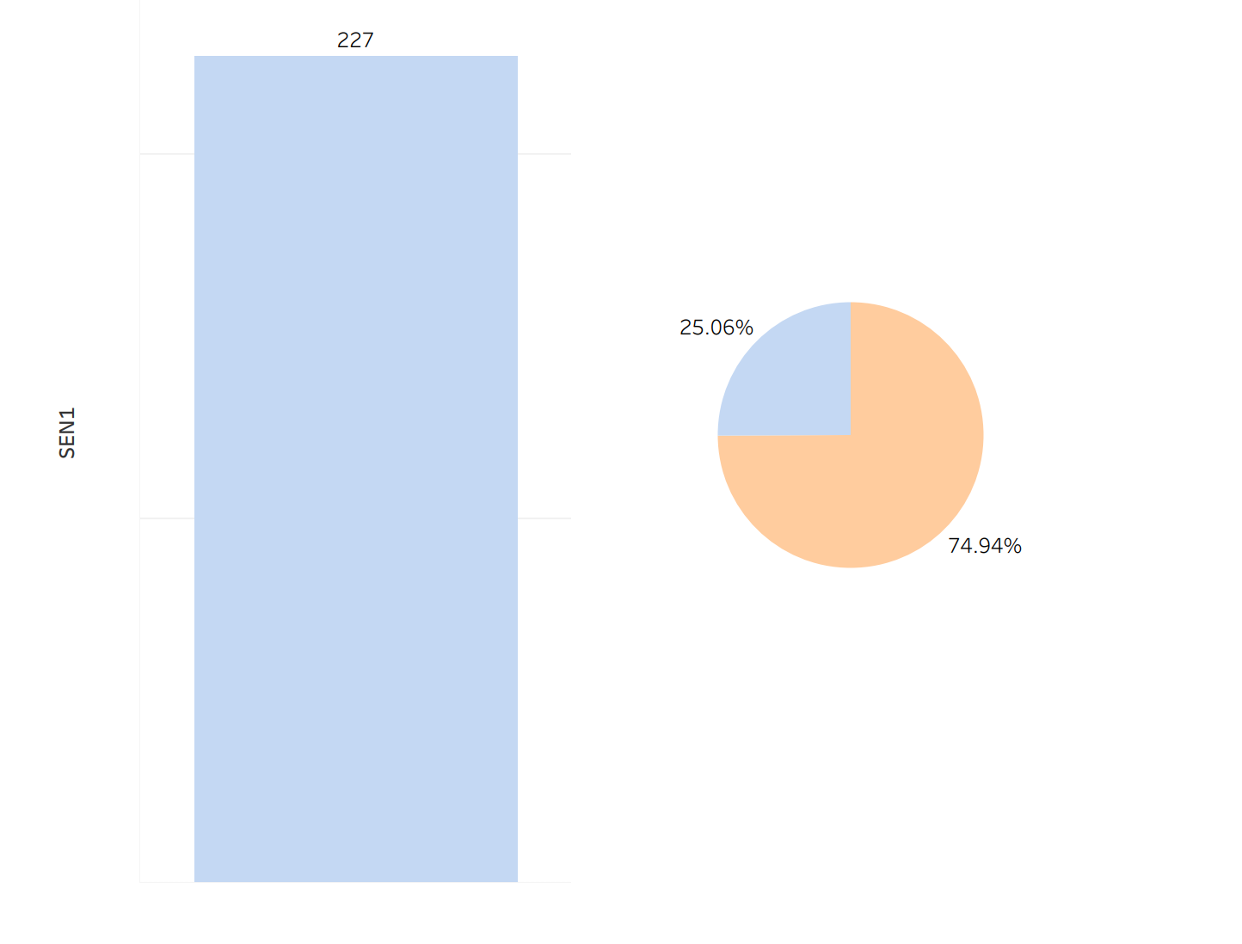
Students with Special Educational Needs (SEN)
SEN Students
Students without SENs

Slide 12
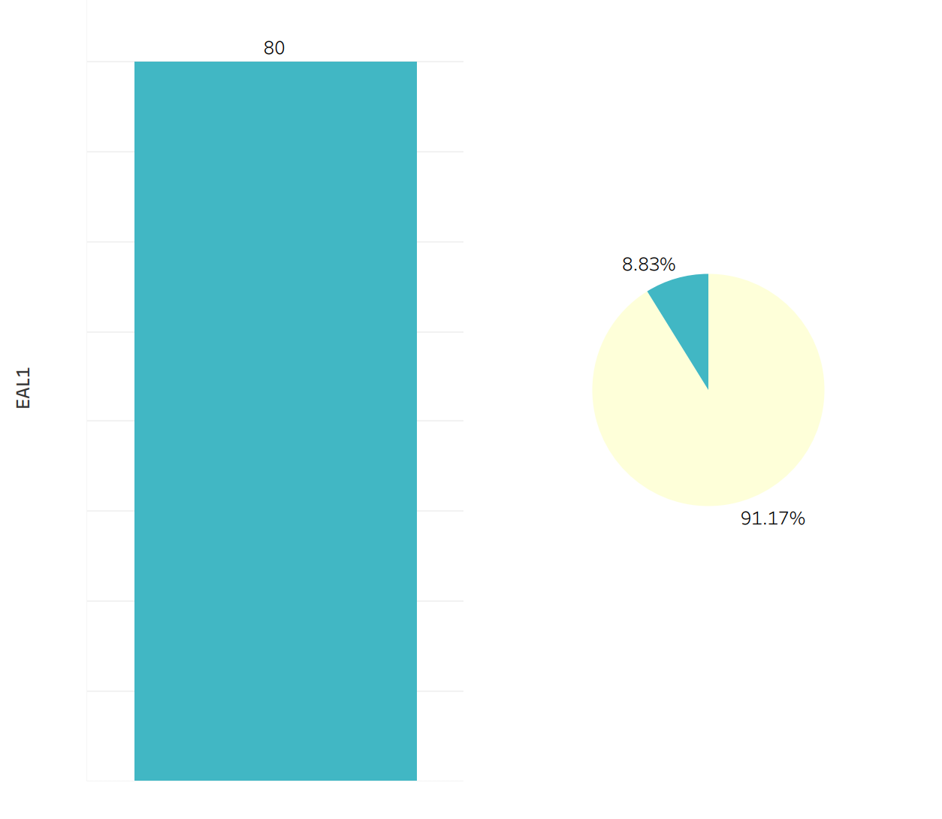
Students with English as a Second Language
Students with English as a second Language
Students without English as a Second Language

Slide 13
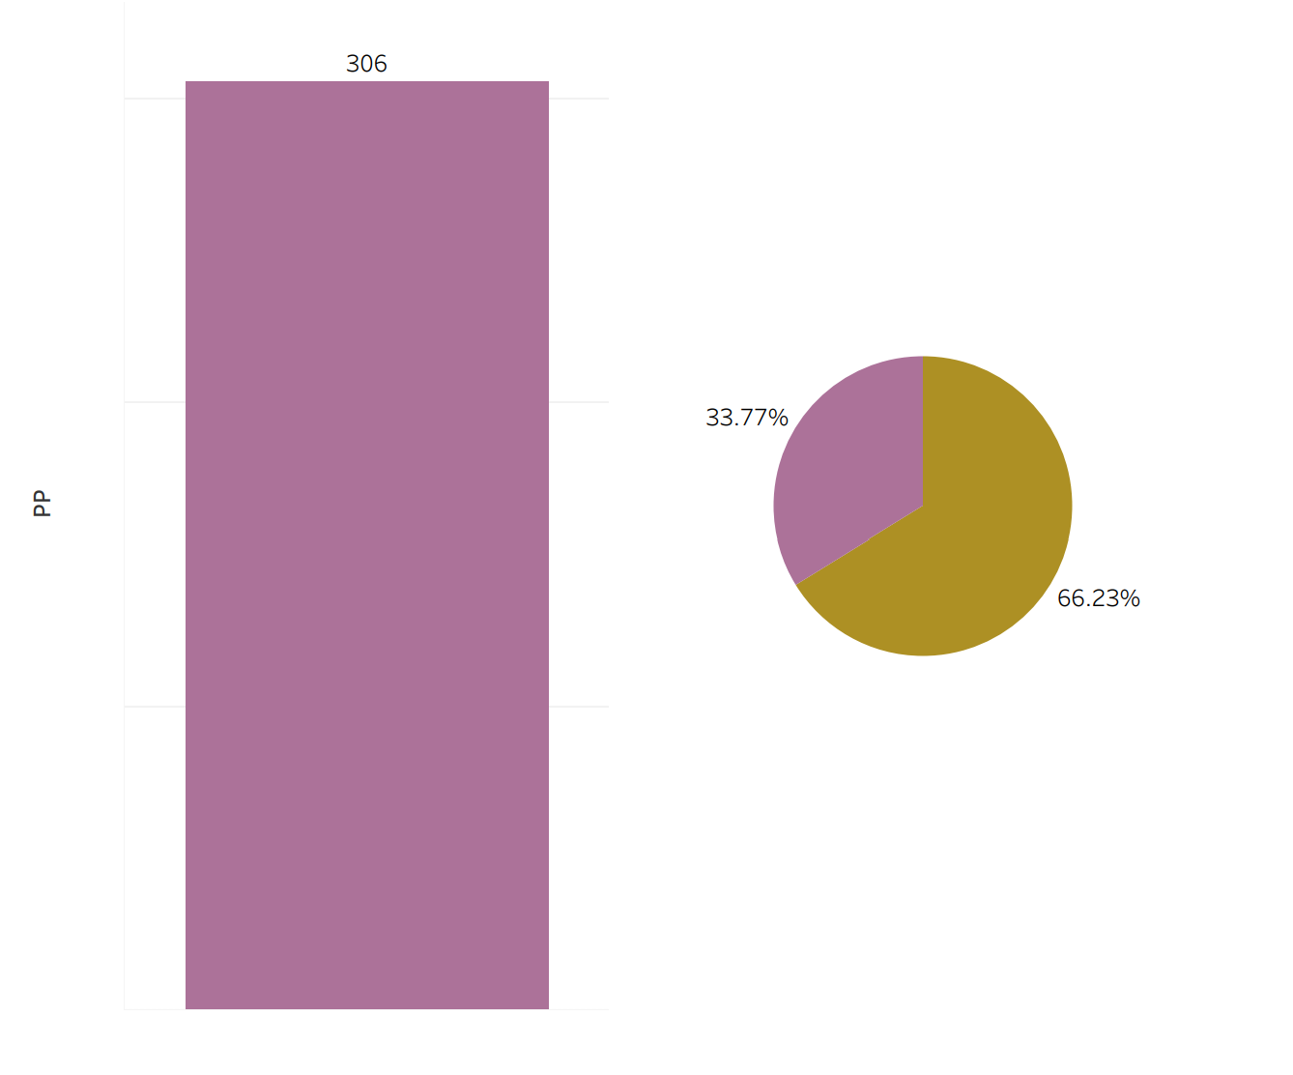
Students that Receive Pupil Premium Funding
Students with Pupil Premium
Students without Pupil Premium

Slide 14
Summary
This dataset showed that there was a significance between the students that received the pupil premium, students with special educational needs and students with English as a second language and their grades.
The dataset also was able to have the student’s grades predicted with 98.9% accuracy.

Slide 15
Conclusion
Overall, this analysis will help teachers and administrators predict student grades and help their potential areas of weaknesses.
It will also allow them to see students’ strengths and areas with which do not need further learning assistance.
This process and machine learning is a great tool that won’t replace students earning their actual grades. However, it will enhance the viewpoint of teachers and administrators to be able to further assist students.

